Slide 1
COMPSCI 373 S1C Computer Graphics and Image Processing
Computer Graphics using OpenGL
Chapter 3: Ray Tracing

Slide 2
3.1 Introduction to Ray Tracing
Outline
Introduction to Ray Tracing
Ray Casting
Intersecting Rays with Primitives
Intersecting Rays with Transformed Primitives

Slide 3

Why Ray Tracing?
Real physics
Light interacts with objects in the scene (absorption, reflection, scattering etc.)
Even approximations very slow (Radiosity, path tracing)
Polygon Rendering
Project polygons onto view plane and calculate perceived colour using direct light contribution only => images not photorealistic
Ray Tracing
Simulate physics by tracing light rays in inverse direction starting from eye point (see next slide)
Can model more complex light interactions than polygon rendering (=> more realistic images)

Slide 4
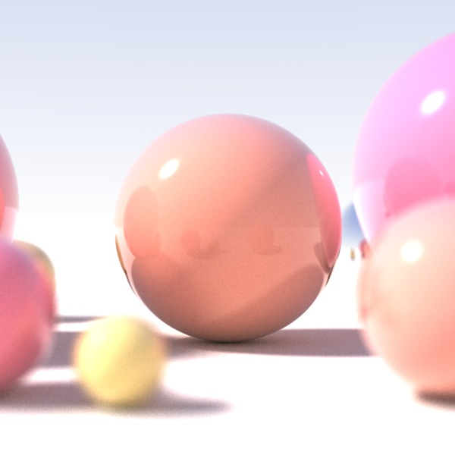
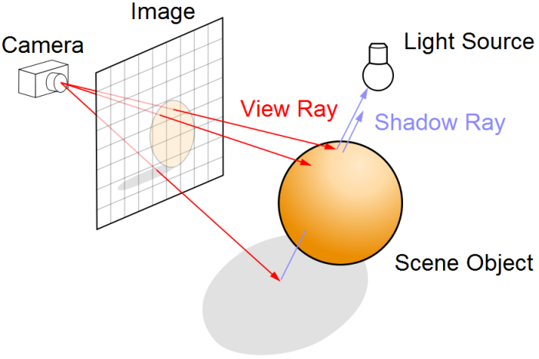

INTRODUCTION TO
RAY TRACING
Images thanks to Henrik and Tim Babb

Slide 5
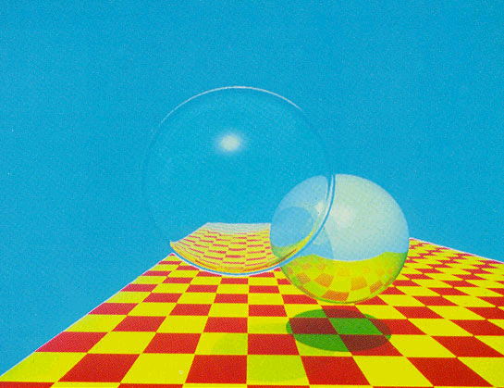
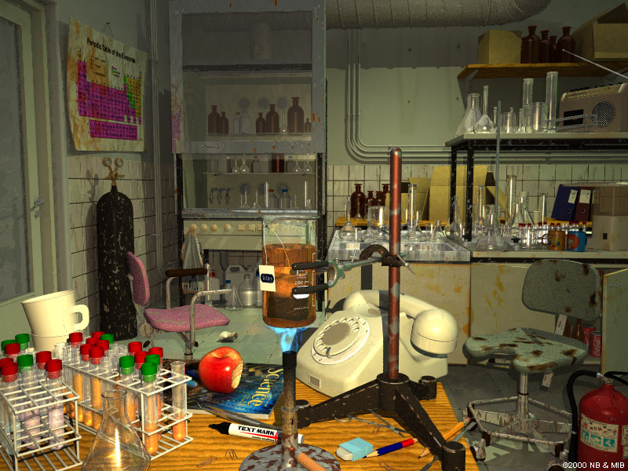


Ray Tracing Image Gallery
T. Whitted,1979
(44 mins on VAX)
“A Dirty Lab”
M. Borbely, 2000
Internet Ray Tracing Competition Winner
Terragen,
thanks to T1g4h

Slide 6
Introduction to Ray Tracing
Polygon Rendering
Visible polygons are projected onto a view plane
Polygons made more realistic with texture mapping and shading
Considers only a single light reflection per pixel
Limited ability to simulate reflections (e.g. environment mapping / reflection mapping)
No refraction, no proper shadows
Ray Tracing
Calculate the path of light rays
Trace a light ray through several reflections, refractions, …
Proper shadows where light rays do not hit a surface directly
Much slower than polygon rendering, but can be photorealistic!

Slide 7


How to Trace Rays?
Trace light rays starting from a light source
  Physically accurate
  Essentially unlimited number of rays
  Only a small fraction actually reaches the eye
  Very, very slow for CGI, but possible (→ Monte-Carlo)
Trace only the light rays that hit the eye backwards
  Not as accurate, but much faster!!!
  Can follow the ray backwards through as many
  reflections and refractions as we like
  For each object-ray intersection, we can calculate
  reflected light using an illumination model
Notes:
Also bi-directional light tracing possible

Slide 8
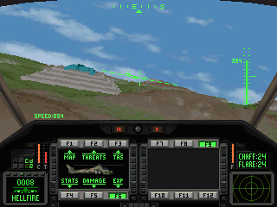
RAY CASTING
Only shadow rays
No reflected rays
Image thanks to Henrik
Comanche, 1992

Slide 9
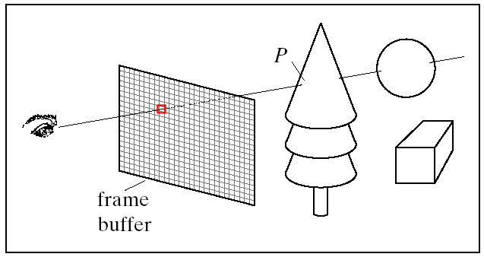
Looking through the View Plane
What do we see through pixel (c,r) for all c and r ?
Trace rays from eye into scene
Describe each point p on ray going through eye in direction d by:
p = eye + t d (one point for each t)
d
Hill textbook,
Fig. 14.1
eye

Slide 10
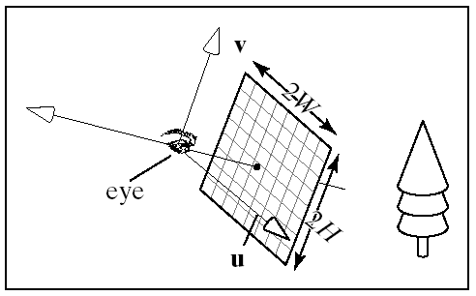
Setting Up the View Plane
Given:
Camera position eye
View coord. system axes (u, v, n)
View plane width 2W
View plane height 2H
View plane distance from eye N
(usually N = 1)
Number of pixel rows nRows and pixel columns nCols in view plane. The number of pixels nRows x nCols is the image resolution
Wanted: ray (startPoint, direction) from eye through every pixel
startPoint is always eye
Center of view plane: center = eye – N n
n

Slide 11
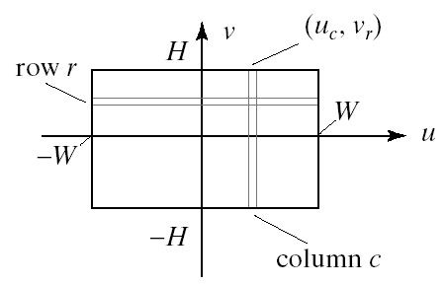
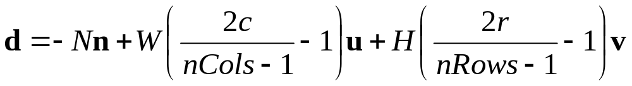
Constructing Rays
Wanted: ray (startPoint, direction) from eye through every pixel
Corners of the view plane in world coords:
bottomLeft = centre - Wu - Hv
bottomRight = centre + Wu - Hv
topLeft = centre - Wu + Hv
topRight = centre + Wu + Hv
Go through all pixels, with column 0 and row 0 at bottomLeft
c = 0, … , nCols -1 and r = 0, … , nRows -1
Ray direction d = pixelPos - eye
Notes:
For nCols=nRows=3 points are:
c=0, r=0 => -Nn-Wu-Hv (bottom left corner)
c=1, r=0 => -Nn-Hv (bottom center)
c=2, r=0 => -Nn+Wu-Hv (bottom right corner)
c=0, r=1 => -Nn-Wu (middle left corner)
c=1, r=1 => -Nn (center)
c=2, r=1 => -Nn+Wu
c=0, r=2 => -Nn-Wu+Hv (top left corner)
c=1, r=2 => -Nn+Hv (top center)
c=2, r=2 => -Nn+Wu+Hv (top right corner)

Slide 12

Ray Casting Algorithm
define scene = ({ objects }, { lights })
define camera (eye, u, v, n)
for (int r = 0; r < nRows; r++) {
for (int c = 0; c < nCols; c++) {
construct ray going through (c, r)
find closest intersection of ray with an object (smallest t≥0)
find intersection point P
get the surface normal at P
pixel(c, r) = the color at P as seen by the eye
(e.g. use Phong Illumination equation)
}
}
m
P

Slide 13
Quiz 1
Consider ray casting and increasing the distance N between the eye and the view plane. Which of the following statements describes correctly the effect of this operation on the rendered scene?
(a) Zoom into the scene
(b) Zoom out of the scene
(c) Increase the resolution of the image
(d) Decrease the resolution of the image
(e) None of the others

Slide 14

INTERSECTING RAYS WITH PRIMITIVES

Slide 15
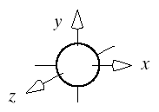
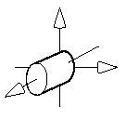
Ray-Object Intersection
Define each object as an implicit function f:
f(p) = 0 for every point p on the surface of the object
(if p is not on surface, then f(p) ≠ 0)
Examples for simple objects (“primitives”):
  Sphere (center at origin, radius 1)
    f(p) = x² + y² + z² – 1 = |p|² – 1
  Cylinder (around z-axis, radius 1)
    f(p) = x² + y² – 1
A ray (eye + d t) intersects the object defined by f(p) = 0 if and only if f(eye + d t) = 0
→ solve for t and get intersection point eye + d t

Slide 16
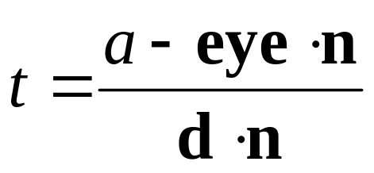
Ray-Plane Intersection
Implicit function for plane (normal n, distance a from origin):
p⋅n – a = 0
Intersection when (eye + t d)⋅n – a = 0
i.e.
If d⋅n=0 then ray parallel to plane (ignore plane)
If t negative then ray directed away from plane (no intersection that can be seen)

Slide 17
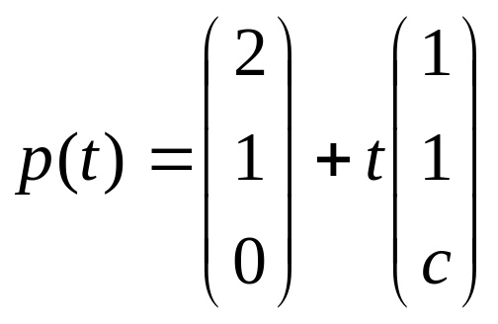
Quiz 2
Given is a plane 2x + 3y – z = 1 and a ray
(a) For what value of c does the ray not intersect the plane?
(b) For what value of c does the ray intersect the plane for t=1?
What is the intersection point in that case?
Notes:
c=5 since in that case plane normal and ray direction orthogonal (and start point does not lie in plane)
c=11 and p(1)=(3,2,11)

Slide 18
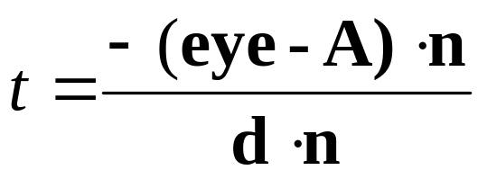
Ray-Triangle Intersection
Normal n = (B-A) × (C-A)
Implicit function for corresponding plane: (p-A)⋅n = 0
Intersection with plane when (eye + t d - A)⋅n = 0
i.e.
Is the ray-plane intersection at p=(eye + t d) inside the triangle?
  Calculate scalars for three cross products (normals for the plane):
  ((B-A) × (p-A))⋅n and ((C-B) × (p-B))⋅n and ((A-C) × (p-C))⋅n
  If they all have the same sign (e.g. all negative) then p is inside the triangle
  Each tests if p is on the inside or outside of one of the edges
  If p on the inside of an edge, then normal is directed towards us
C
B
A
Notes:
Note that for ray triangle intersection and point on triangle can be used since, e.g. B=A+(B-A)
and (B-A).n = 0 => A.n=B.n=C.n

Slide 19
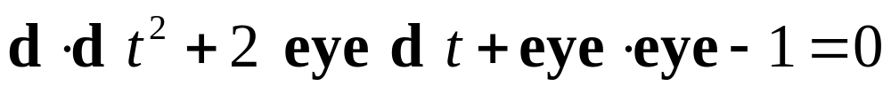
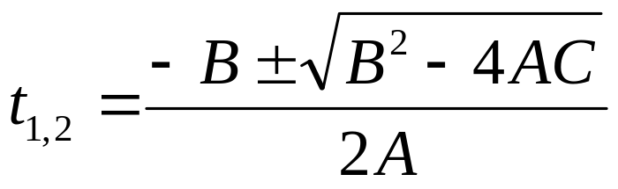
Ray-Sphere Intersection
  Implicit function for sphere (center at origin, radius 1):
  p⋅p – 1 = 0
Intersection when (eye + t d)⋅(eye + t d) – 1 = 0
i.e.
Solve quadratic equation for t
A=d⋅d
with B=2 eye⋅d
C= eye⋅eye-1
If (B²-4AC)<0 then ray misses sphere
If (B²-4AC)=0 then ray grazes sphere (treat as miss)
If (B²-4AC)>0 then one t for entry and one t for exit point
(use smaller t for intersection, → closer to eye)

Slide 20

Quiz 3
Given is a sphere with radius 1 centered at the origin and a ray
Does the ray intersect the sphere?
If yes, how many times and what is the first intersection point?
Notes:
Only one intersection point for t=2 =? p(2)=(0,1,0)

Slide 21
Ray-Cylinder Intersection
  Implicit function for circle (one end at origin, radius 1, length 1):
  x² + y² – 1 = 0 and 0 ≤ z ≤ 1
Intersection when 0 ≤ eye_{z} + t d_{z} ≤ 1
and
(eye_{x} + t d_{x})⋅(eye_{x} + t d_{x}) + (eye_{y} + t d_{y})⋅(eye_{y} + t d_{y}) – 1 = 0
i.e.
Solve quadratic equation for t (same as for sphere)
Check if 0 ≤ eye_{z} + t d_{z} ≤ 1 (otherwise miss)
Note: cylinder is open at the ends and hollow on the inside

Slide 22
Summary
Ray tracing is slow, but can give us photorealistic images
  Tracing the light rays that hit the eye backwards
  Trace each light ray through several reflections, refractions, …
Ray casting: simple form of ray tracing
  Trace one ray per screen pixel
  Trace only until it hits an object (i.e. no reflections)
Calculate ray-object intersections by putting ray equation into implicit object function and solving for t
References:
  Introduction to Ray Tracing: Hill, Chapters 12.1 - 12.3
  Ray-Object Intersection: Hill, Chapter 12.4

Slide 23
3.2 A Simple Ray Tracer
Outline
Structure of a Ray Tracer
Implementing a Ray Caster
Lights and Shadows

Slide 24
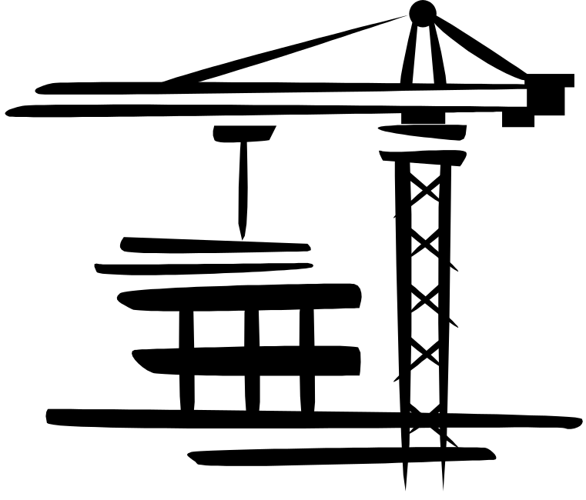

STRUCTURE OF A RAY TRACER

Slide 25
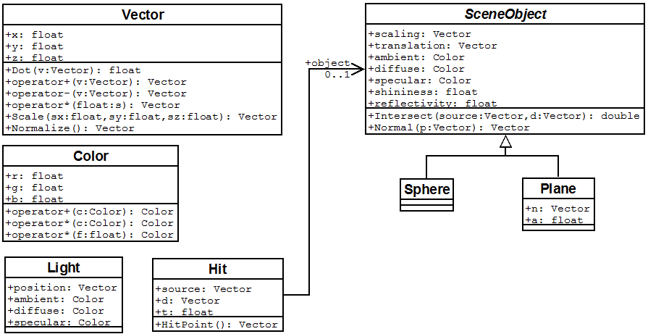
Ray Tracer Class Diagram
RayTracer.cpp
Hit intersect(Vector source, Vector d)
Color shade(Hit hit, int reflectionNo)
void display(void)
void init(void)
int main(int argc, char** argv)

Slide 26
Class Vector
#pragma once
#include <cmath>
class Vector {
public:
Vector();
Vector(float x, float y, float z);
~Vector(void);
float x, y, z;
float Dot(Vector v); // dot product
Vector operator+(Vector v);
Vector operator-(Vector v);
Vector operator*(float s);
Vector Scale(float sx, float sy, float sz);
Vector Normalize();
};
#include "Vector.h"
Vector::Vector() { }
Vector::Vector(float x, float y, float z) { … }
Vector::~Vector(void) { }
float Vector::Dot(Vector v) {
return x*v.x + y*v.y + z*v.z;
}
Vector Vector::operator+(Vector v) {
return Vector(x+v.x, y+v.y, z+v.z);
}
Vector Vector::Normalize() {
float l = sqrt(this->Dot(*this));
return Vector(x/l, y/l, z/l);
}
…
Vector.h
Vector.cpp

Slide 27
Class Color
#pragma once
class Color {
public:
Color();
Color(float r, float g, float b);
~Color(void);
float r, g, b;
Color operator+(Color c);
Color operator*(Color c);
Color operator*(float s);
};
#include "Color.h"
Color::Color() { }
Color::Color(float r, float g, float b) {
this->r = r; this->g = g; this->b = b;
}
Color::~Color(void) { }
Color Color::operator+(Color c) {
return Color(r + c.r, g + c.g, b + c.b);
}
Color Color::operator*(Color c) {
return Color(r * c.r, g * c.g, b * c.b);
}
Color Color::operator*(float s) {
return Color(s*r, s*g, s*b);
}
Color.h
Color.cpp

Slide 28
The Main File: RayTracer.cpp
#include <windows.h>
#include <gl/glut.h>
#include <algorithm>
#include "Color.h“ …
int windowWidth = 400, windowHeight = 400;
const int numObjects = 1;
SceneObject* objects[numObjects];
const int numLights = 1;
Light* lights[numLights];
Color background = Color(0.5, 0.8, 1);
Vector eye = Vector(0, 0, 4);
Vector u = Vector(1, 0, 0);
Vector v = Vector(0, 1, 0);
Vector n = Vector(0, 0, 1);
float N = 1, W = 0.5, H = 0.5;
void init(void){
glClearColor (0.0, 0.0, 0.0, 0.0);
glMatrixMode(GL_PROJECTION);
glLoadIdentity();
gluOrtho2D(0, windowWidth,
0, windowHeight);
setupScene();
}
int main(int argc, char** argv) {
glutInit(&argc, argv);
glutInitDisplayMode(GLUT_SINGLE | GLUT_RGB);
glutInitWindowSize(
windowWidth, windowHeight);
…
}
Headers
Orthogonal projection
Scene
objects
Lights
Camera

Slide 29

IMPLEMENTING A RAY CASTER
Diagram thanks to Henrik

Slide 30
Casting Rays
void display(void) {
glClear(GL_COLOR_BUFFER_BIT);
glBegin(GL_POINTS);
for(int r=0; r<windowHeight; r++) {
for(int c=0; c<windowWidth; c++) {
// construct ray through (c, r)
// using u,v,n and H,W
Vector d = Vector( ? , ? , ? );
// intersect ray with scene objects
Hit hit = intersect(eye, d);
// shade pixel accordingly
Color color = shade(hit);
glColor3f(color.r, color.g, color.b);
glVertex2f((GLfloat)c, (GLfloat)r);
} }
glEnd(); glFlush (); }
We are drawing the points on the viewplane, starting at bottom left
Ray starts at eye and has direction d (→ calculate d)
intersect(eye,d) gives us info about first hit of the ray
shade(hit) gives us the color of the point where the ray hit an object (or hit no object at all)
See Assignment ☺

Slide 31
Representing Objects
#pragma once …
class SceneObject {
public:
Vector scaling, translation;
Color ambient, diffuse, specular;
float shininess;
float reflectivity;
// returns the t value of the closest ray-
// object intersection, or -1 otherwise
virtual double Intersect(
Vector source, Vector d) = 0;
// returns normal at the given point p
// if p not on object, result is undefined
virtual Vector Normal(Vector p) = 0;
};
#pragma once …
class Sphere : public SceneObject {
public:
Sphere(void); ~Sphere(void);
double Intersect(Vector source, Vector d);
Vector Normal(Vector p);
};
For this basic ray caster we use only green parts
scaling and translation for transformed objects
ambient, specular colors and shininess for Phong illumination
reflectivity for ray reflection
SceneObject.h
Sphere.h

Slide 32
Setting Up Scene Objects
Sphere* s = new Sphere();
// no scaling or translation
s->scaling = Vector(1, 1, 1);
s->translation = Vector(0, 0, 0);
// Phong material parameters
s->ambient = Color(0.1, 0.1, 0.1);
s->diffuse = Color(1.0, 0.2, 0.2);
s->specular = Color(0.7, 0.7, 0.7);
s->shininess = 50;
// ray reflection parameter
s->reflectivity = 0.4;
// put into objects array
objects[0] = s;
// similar for plane…
Set up objects in global variable:
const int numObjects = 2;
SceneObject* objects[numObjects];
Set up background color:
Color background =
Color(0.5, 0.8, 1);
Analogous for planes, but need to set more parameters: n and a
For now we ignore scaling and translation, but later we support scaled and translated objects

Slide 33
Sphere.cpp
double Sphere::Intersect(
Vector source, Vector d) {
float A = d.Dot(d);
float B = 2*source.Dot(d);
float C = source.Dot(source) - 1;
if(B*B - 4*A*C <= 0) return -1; // no hit
float t1;
if(B>0) // for numerical precision
t1 = (-B - sqrt(B*B - 4*A*C)) / (2*A);
else
t1 = (-B + sqrt(B*B - 4*A*C)) / (2*A);
float t2 = C/(A*t1); // easier way to get t2
if(t1<t2) return t1; // need only closer t
else return t2;
}
Vector Sphere::Normal(Vector p) {
return p.Normalize();
}
Class Sphere implements intersection and normal for sphere primitive
(at origin with radius 1)
If no intersection: return -1
Also need to create class Plane
Fields: Vector n (normal) and float a (distance from origin)
Implement Intersect

Slide 34
Class Hit
#pragma once
#include "Vector.h"
#include "SceneObject.h"
class Hit {
public:
Hit(void);
Hit(Vector source, Vector d, float t,
SceneObject* object);
~Hit(void);
Vector source;
Vector d;
float t;
SceneObject* object;
Vector HitPoint();
};
#include "Hit.h"
Hit::Hit(void) { }
Hit::Hit(Vector source, Vector d, float t, SceneObject* object) {
this->source = source;
this->d = d;
this->t = t;
this->object = object;
}
Hit::~Hit(void) { }
Vector Hit::HitPoint() {
// calculate intersection point
// using source, d and t
return Vector(source.x + t*d.x,
source.y + t*d.y, source.z + t*d.z);
}
Hit.h
Hit.cpp

Slide 35
intersect and shade
Hit intersect(Vector source, Vector d) {
// initially hit object==NULL (→ no hit)
Hit hit = Hit(source, d, -1, NULL);
// for every object, check if ray hits it
for(int i=0; i<numObjects; i++) {
float t = objects[i]->Intersect(source, d);
// 1. only use hits visible for the camera
// 2. only overwrite hit if either there is
// no hit yet, or the hit is closer
if(t>0.00001
&& (hit.object==NULL || t<hit.t))
hit = Hit(source, d, t, objects[i]);
}
return hit;
}
Color shade(Hit hit) {
// if no object was hit,
// return background color
if(hit.object==NULL)
return background;
// otherwise use diffuse object color
return hit.object->diffuse;
}
Both in RayTracer.cpp
intersect finds the hit of a ray with an object closest to the camera
If hit.object==NULL, then the ray did not hit anything

Slide 36
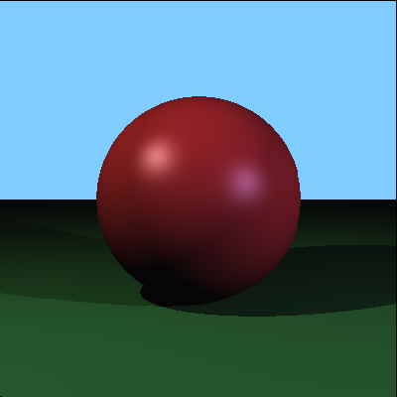
LIGHTS AND SHADOWS
Diagram thanks to Henrik

Slide 37
Setting Up Point Lights
#pragma once
#include "Color.h"
#include "Vector.h"
class Light {
public:
Light(void); ~Light(void);
Vector position;
Color ambient, diffuse, specular;
};
#include "Light.h"
Light::Light(void) { }
Light::~Light(void) { }
Set up lights in global variable:
const int numLights = 2;
Light* lights[numLights];
Code for setting up a light:
Light* l = new Light();
l->position = Vector(-2, 2, 2);
l->ambient = Color(0.1, 0.1, 0.1);
l->diffuse = Color(0.5, 0.5, 0.5);
l->specular = Color(0.5, 0.5, 0.5);
lights[0] = l;
// similar for second light…
Light.h
Light.cpp

Slide 38
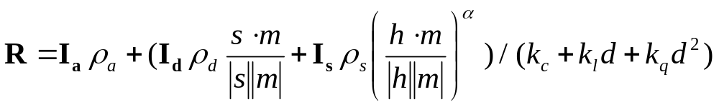
Adding Phong Illumination to shade
Color shade(Hit hit) {
if(hit.object==NULL) return background;
Color color = Color(0,0,0);
for(int i=0; i<numLights; i++) {
// ambient reflection
color = color + hit.object->ambient
* lights[i]->ambient;
Vector p = hit.HitPoint();
Vector v = hit.source - p;
Vector s = lights[i]->position - p;
Vector m = hit.object->Normal(p);
// make sure light hits the front face
if (s.Dot(m) < 0) continue
// diffuse reflection
color = color + hit.object->diffuse * lights[i]->diffuse * s.Normalize().Dot(m);
// specular reflection
Vector h = (s.Normalize() +
v.Normalize()).Normalize();
color = color + hit.object->specular *
lights[i]->specular *
pow(h.Dot(m), hit.object->shininess);
}
return color;
}
R_{d,s}
In many cases division by distance is omitted
Angle between
s and m

Slide 39
Shadow Feelers
Problem: How do we know if a point p is in shadow of a light l ?
Solution: Check if there is something between p and l
Calculate (source, d) for a ray
that starts at p and goes to l
(a “shadow feeler”)
Check if there is an intersection
with any scene object
(→ use intersect)
If there is a ray-object intersection
between p and l then:
do not illuminate p with the light
i.e. do not add R_{d} and R_{s}
Otherwise: normal illumination

Slide 40
Adding Shadows to shade
Color shade(Hit hit) {
if(hit.object==NULL) return background;
Color color = Color(0,0,0);
for(int i=0; i<numLights; i++) {
// ambient reflection …
// make sure light hits the front face …
// cast a "shadow feeler“
Hit feeler = intersect(p, s);
if(feeler.object==NULL || feeler.t<0 ||
feeler.t>1) {
// diffuse reflection
color = color + … ;
// specular reflection
color = color + … ; }
return color;
}
Three different non-shadow cases:
“no hit”: no object was hit at all
“hit before p”: the closest hit is on the other side of p
(→ no object between l and p)
“hit after l”:
the closest hit is after l
(→ no object between l and p)
“hit before p”
“no hit”
“hit after l”
l
after l
p
before p

Slide 41
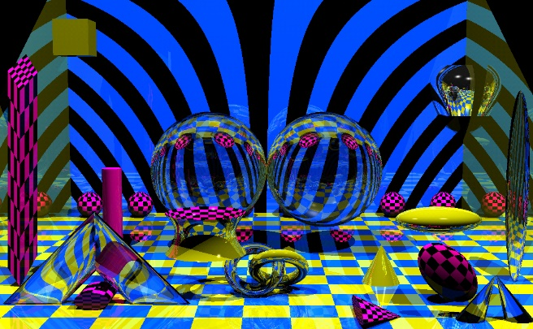
Quiz 4
With ray-tracing, which of the following, if any, is NOT required during shadow determination:
(a) Determine a new start point (start point of shadow ray)
(b) Iterate through objects in the scene
(c) Perform intersection tests (Hit method) with objects
(d) Determine a new ray direction (ray direction of shadow ray)
(e) All of the others are required
In ray tracing, which illumination component(s) from Phong's model are used to compute the colour of objects in shadow?
Notes:
Q1: “(e) all of the others are required” is CORRECT
Q2: ambient

Slide 42
3.3 From Ray Casting to Ray Tracing
Outline
Ray Tracing Reflections
Ray Tracing Transformed Primitives
Speeding Up Ray Tracing

Slide 43
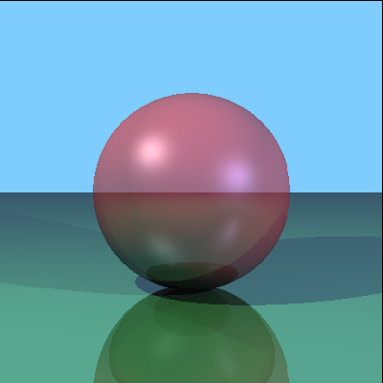
RAY TRACING REFLECTIONS
Diagram thanks to Henrik

Slide 44
Ray Tracing Reflections
Idea: the color of a point is influenced by the color that the ray carries over from the previous reflection
Reflectivity: fraction of incident radiation reflected by a surface (between 0 and 1)
Add the fraction of light reflected from q to the reflection at p:
Ray is reflected at q (blue sphere)
before being reflected at p (white box)
→ ray has bluish color when it hits
the box
q
p

Slide 45
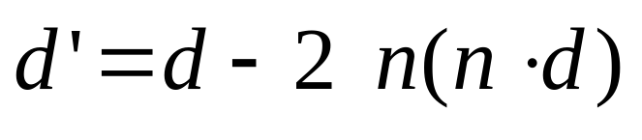
Perfect Ray Reflection
Given: incoming ray direction d
Wanted: outgoing ray direction d’
Reflection rule: incoming angle = outgoing angle (both are φ)
In diagram:
  Horizontal component of d stays the same
  Only vertical component is reversed
  (ray bounces off)
  Use dot product to get the
  vertical component
  (-n ⋅ d = cos(φ) ⋅ |d| ⋅ |n|, |n|=1)
n
d
d'
-n(n⋅d)
-n(n⋅d)
φ
φ
p
φ
d
-n⋅d
-n(n⋅d)
-n

Slide 46
Adding Reflections to shade
Color shade(Hit hit, int reflectionNo) { …
// if no hit, return background color…
// calculate p and m…
for(int i=0; i<numLights; i++) {
// ambient, diffuse, specular reflection
}
// ray reflection
if(reflectionNo<maxReflections &&
hit.object->reflectivity>=minReflectivity) {
Hit reflection = intersect(p,
hit.d - m*2*hit.d.Dot(m));
color = color + hit.object->specular * lights[i]->specular
* pow(h.Dot(m), hit.object->shininess); }
return color;
}
Make sure that there is a maximum number of reflections
Calculate reflection only for fairly reflective surfaces
Cast reflection ray using intersect
Add light coming from reflection ray (attenuated by reflectivity) to the color (calling shade recursively)
q
p

Slide 47

SPEEDING UP RAY TRACING

Slide 48

Tracing Rays in Parallel
Tracing one ray after the other is slow
Observation: calculations for different primary rays are independent
Idea:
  trace primary rays in parallel
  For n pixels and m processors (pixel shaders on GPU), each processor traces only n/m pixels
nVidia offers OptiX ray Tracing Engine – used by many commercial ray tracers, e.g. Iray, Pixar RTP, FurryBall

Slide 49



Object Extents
Without optimization: each ray must be tested for intersection with every object
Extent: simple shape that encloses one or more objects
Helps to rule out intersections: if ray does not hit extent, then it also does not hit contained objects
Typical extents: spheres (“bounding spheres”), boxes aligned with coordinate axes (“bounding boxes”)
Extents can be used hierarchically,
i.e. extents nested in extents

Slide 50
Using Spheres as Extents
We know how to intersect a ray (eye, d) with a (primitive) sphere:
A=d⋅d
with B=2 eye⋅d
C= eye⋅eye-1
Interesting case for use as extent:
if (B²-4AC)<0 then ray misses sphere (fast to compute)
The more objects are in a bounding sphere, the less intersection tests are necessary if the ray does not hit it
Research problem: how do we place hierarchical bounding spheres automatically? (also for other extent types)

Slide 51
Space Subdivision
Idea: subdivide the world into subspaces
Speedup by excluding some subspaces (and their objects)
Subdivision can be done recursively
Examples: Octrees, binary space division (BSP) trees, KD-trees

Slide 52
Item Buffer
Idea: for each pixel, store which object is visible (similar to depth buffer)
Item buffer can be generated quickly by iterating over objects, with techniques from polygon rendering
For primary rays (those going through the pixels) we know immediately which object they hit
Use buffer with
closest object
for each pixel

Slide 53
Quiz 5
How do we consider light reflected from another surface?
What is an extent? Why is it useful?

Slide 54
Summary
Ray tracing reflections
  Construct reflection ray and call shade recursively
  Add reflectivity times color from previous reflection to current color
Speeding up ray tracing: extents, space subdivision, item buffer
References:
  Ray Tracing Reflections: Hill, Chapter 12.12
  Using Extents: Hill, Chapter 12.10

Slide 55
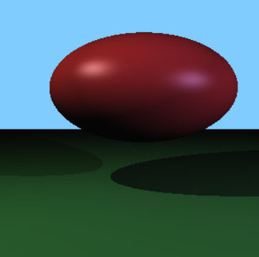
RAY TRACING
TRANSFORMED PRIMITIVES

Slide 56
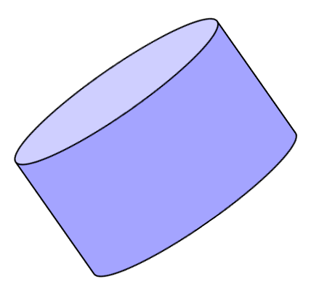
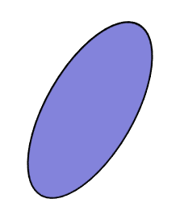
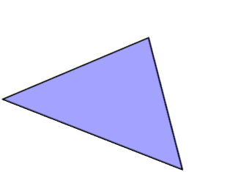
INTERSECTING RAYS WITH TRANSFORMED PRIMITIVES

Slide 57
Transformed Primitives
Problem: How to intersect with transformed primitives?
(e.g. scaled and translated unit sphere)
Solution: intersection of ray with transformed primitive is the same as intersection with inversely transformed ray and primitive
Intersect with transformed ray (eye_{t} + d_{t} t)
i.e. eye_{t} = M⁻¹ eye and d_{t} = M⁻¹ d
t for the intersection is the same in world and primitive space
M
Primitive
Space
World
Space
M⁻¹

Slide 58
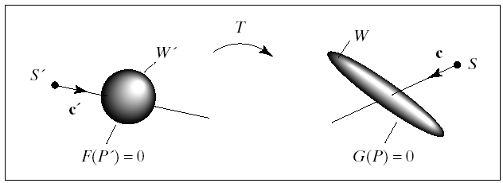
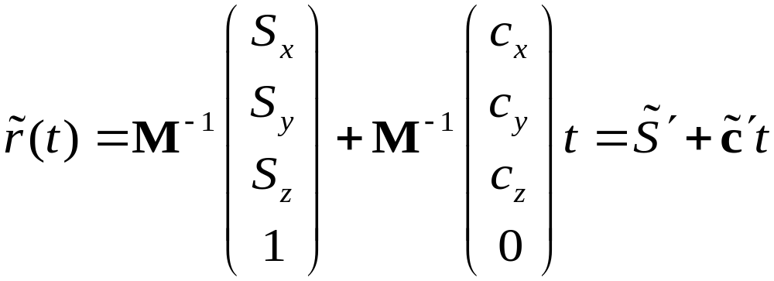
Transformed Primitives
T^{-–1}
Homogeneous component 0 because vector is a direction and not a point
© 2004 Lewis Hitchner, Richard Lobb & Kevin Novins

Slide 59
Transformed Primitives
M*G
p_{ij} = r_{ij} ∩ M*G
G
p_{ij} = r_{ij} ∩ G
r_{ij} = s + c_{ij}t
r_{ij} = s + c_{ij}t
G = M⁻¹ (M*G)
© 2004 Lewis Hitchner, Richard Lobb & Kevin Novins

Slide 60
Transforming Rays
Ray has position vector (point) source and direction vector d
Scaling: both source and direction d change
Translation: source changes, but the direction d does not
(point source has w=1, but direction vector d has w=0)
If M=T S then inverse ray transformation is:
source’ = S⁻¹ T⁻¹ source and d’ = S⁻¹ d
S
T

Slide 61
Quiz 6
A common way to find intersections of a ray with a primitive object that was transformed with a modelling transformation M is to:
(a) Transform the ray with M and calculate
intersections with the untransformed
primitive object
(b) Transform the ray with M⁻¹ and calculate intersections with the
untransformed primitive object
(c) Transform the ray with M and calculate intersections with the primitive
object after transforming it with M
(d) Transform the ray with M and calculate intersections with the primitive
object after transforming it with M⁻¹
(e) None of the others
Notes:
CORRECT ANSWER: (b)

Slide 62

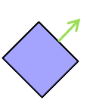

Surface Normals
Problem:
After transforming a vertex, its surface normal needs to be adjusted
The direction might be wrong
The length might not be 1 anymore
Examples:
Direction ok
Length=1
Direction ok
Length=1
T
R
Direction ok
Length≠1
Direction wrong
Length≠1
S
H

Slide 63
Transformation of Surface Normals
How to adjust surface normal n after arbitrary transformation M ?
Answer: adjust by transforming with Q = (M⁻¹)^{T} = (M^{T})⁻¹ = M^{-T}
Proof: let p₁ and p₂ be two points on a polygon with normal n
n⋅(p₂ - p₁) = 0 ⇔ n^{T}(p₂-p₁) = 0 (n perpendicular to polygon)
This has also to be true after transforming p₁ and p₂ by M
and n by Q, i.e. (Qn)^{T}(M(p₂-p₁)) = 0
Apply rule from matrix algebra: (Qn)^{T}=n^{T}Q^{T}:
n^{T}Q^{T}M(p₂-p₁) = 0 whenever n^{T}(p₂-p₁) = 0
Solution is Q^{T}M=I ⇒ Q^{T} = M⁻¹ ⇒ Q = (M⁻¹)^{T} = M^{-T}
Note: the adjusted normal is not always normalized

Slide 64
Normals for Transformed Primitives
Recap: given a normal n, after a transformation M the new normal is n’ with n’ = normalize(M^{–T} n)
Normals are direction vectors (i.e. not affected by translation of the object, w=0)
For normal n and object transformation M=T S the adjusted normal is n’ = normalize(S⁻¹ n)
Sphere normal in our implementation:
Calculated from point p on the transformed sphere
In order to get the adjusted normal n’:
  Calculate corresponding point p_{pr} on primitive sphere: p_{pr} = S⁻¹ T⁻¹ p
  Calculate corresponding normal n_{pr} for the primitive sphere
  Return adjusted n_{pr}

Slide 65

Quiz 7
Given is a sphere with radius 1 centered at the origin. The sphere is
transformed with the matrix
What is the first intersection point of the ray
with the transformed sphere?
Notes:
P(t) where t=2-0.5*sqrt(3)

Slide 66
Quiz 8
Given a modeling transformation M=TS, how do we transform a ray (source, d)?
How do we transform a surface normal n at an intersection point?

Slide 67
Using Transformed Rays
Hit intersect(Vector source, Vector d) {
Hit hit = Hit(source, d, -1, NULL);
for(int i=0; i<numObjects; i++) {
// inversely transform ray with
// object modeling transformation
Vector source2 = ? ;
Vector d2 = ? ;
float t = objects[i]->Intersect(
source2, d2);
if(t>0.00001
&& (hit.object==NULL || t<hit.t))
hit = Hit(source, d, t, objects[i]);
}
return hit;
}
Vector Sphere::Normal(Vector p) {
// get corresponding point p2 on primitive
// sphere by inverting modeling transform
Vector p2 = ? ;
// adjust primitive normal with M^{-T}
return ? ;
}
Vector Plane::Normal(Vector p) {
// adjust primitive normal n with M^{-T}
return ? ;
}
Use transformed ray (source2, d2) to get t
Then use t with original ray
(source, d)

Slide 68
Summary
Ray tracing transformed primitives
  Intersect inversely transformed ray with primitive, get t
  Adjust primitive normal with M^{-T}
  Note: direction vectors are not translated
References:
  Intersection with Transformed Objects: Hill, Chapter 12.4.3

